Slide 1


SALCC SHIRTS WEBSITE
Why was this website created?
Brief background the website
by:Dwayne Quinlan
Notes:
1

Slide 2


Introduction
This website was created due to the fact that Students often encountered uncertainty when purchasing school shirts, not knowing whether their preferred size and color were available before purchasing. This caused delays and dissatisfaction when using the receipt to go pick up the shirts.
Notes:
2

Slide 3
How this website came to mind!
I myself had this problem when i was trying to purchase new shirts one semester where i had to take the receipt for the ALREADY PAID for shirts and make a quick on feet decision on which colour and size i wanted.
Notes:
3

Slide 4

How this website came to mind! (continued)
This posed a question, what if i already had all the colours from the previous semesters. Wouldn't the money i spent buying the new shirts be used for nothing
Notes:
4

Slide 5

The solution
The solution that came to mind was what if i created a website that acted like a real-time stock checker for students:
To see what colours and sizes are in stock before purchasing
To simplify the shirt purchasing system for students
To simplify the shirt distributing system for faculty
Even to help faculty know the best selling categories for restocking
Notes:
5

Slide 6
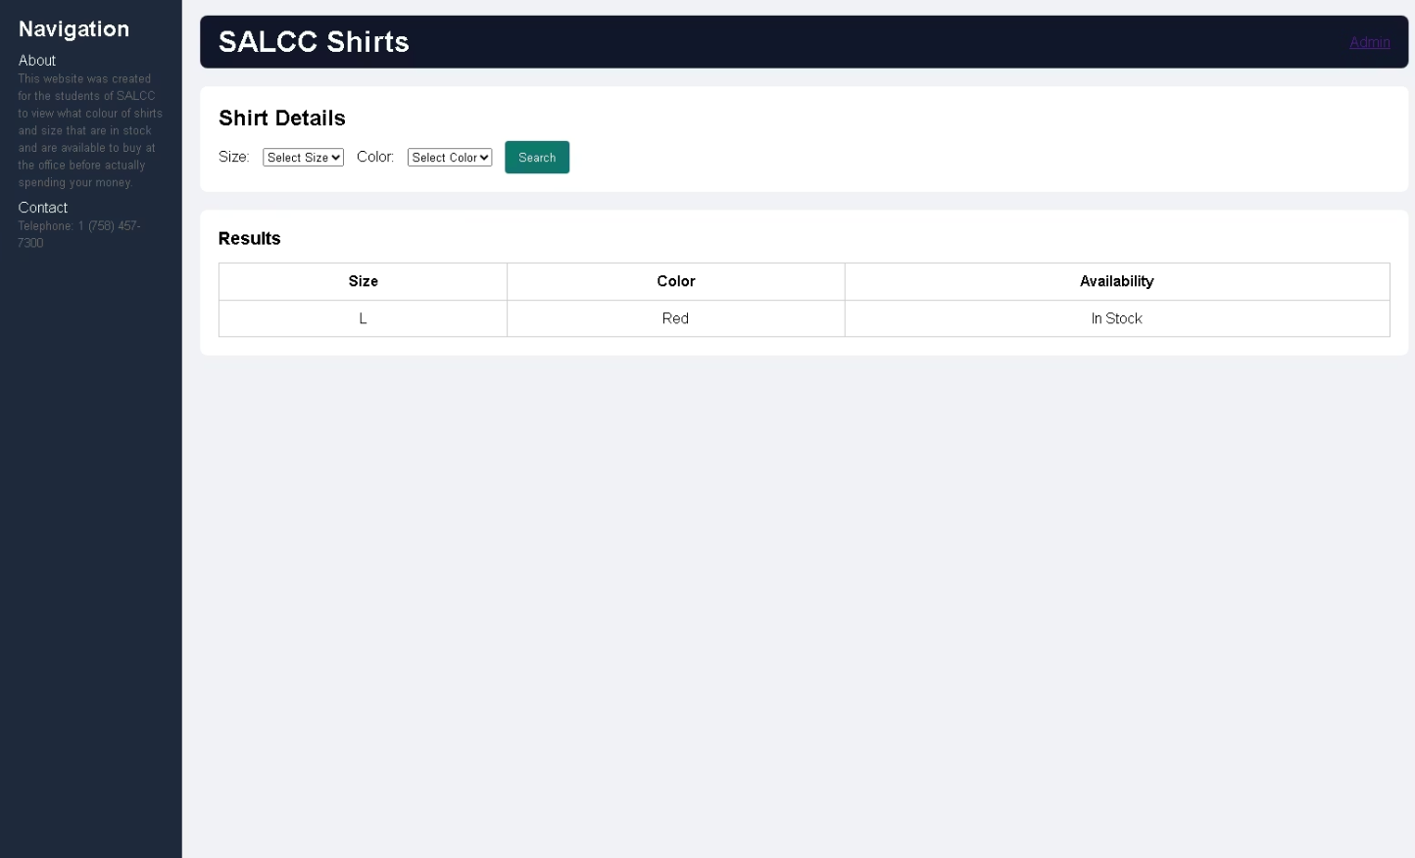
Website overview
Home page of the website
It is simple and professional
includes a search feature
includes an about us(purpose of this creation)
includes the Sir Arthur Lewis Community College number
It also has a section where the admin has to login to edit or change or add shirt option
Notes:
6

Slide 7
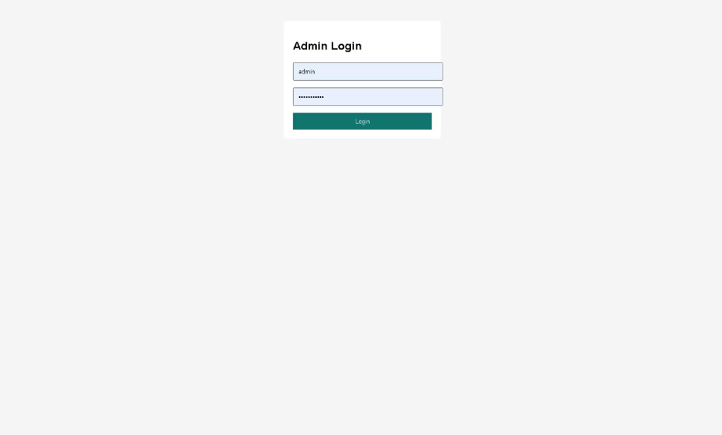
Website overview
Admin Login
This is where the management faculty will enter their Username and their Password that Should not be shared to anyone but the management faculty.
T
Notes:
7

Slide 8
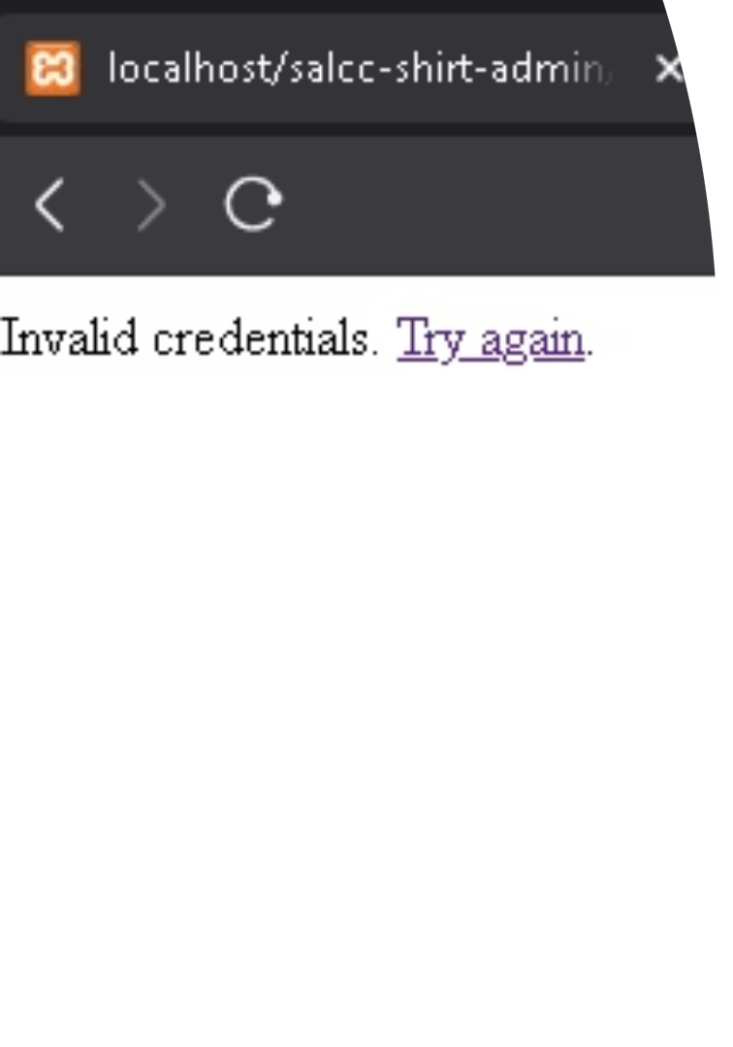
Website overview
Invalid login
as you can see on the left If the password or user name is incorrect it will redirect the entire login screen and output "Invalid credentials. Try again. with the Try again being a hyper link redirecting you to the login page again.(This will be demonstrated at the end)
Notes:
8

Slide 9
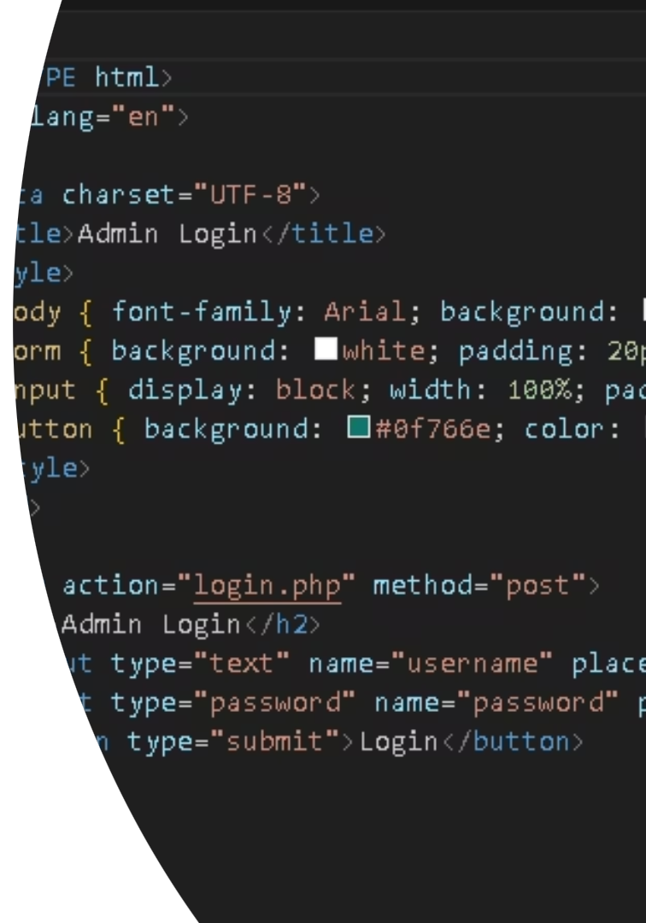
System overview
Languages used to crate the website
Front-End(Client-side):
HTML - For structuring the web pages (index.html, admin.html, admin-panel.php)
CSS - For styling the pages (style.css and inline styles in admin-panel.php and admin.html)
JavaScript - For client-side functionality (script.js)
Backend (Server-side):
PHP - For server-side processing (admin-panel.php, add-shirt.php, login.php, update-stock.php, backend.php)
Database:
MySQL - Used with PHP for database operations (evident from the mysqli connections in PHP files)
Notes:
10

Slide 10
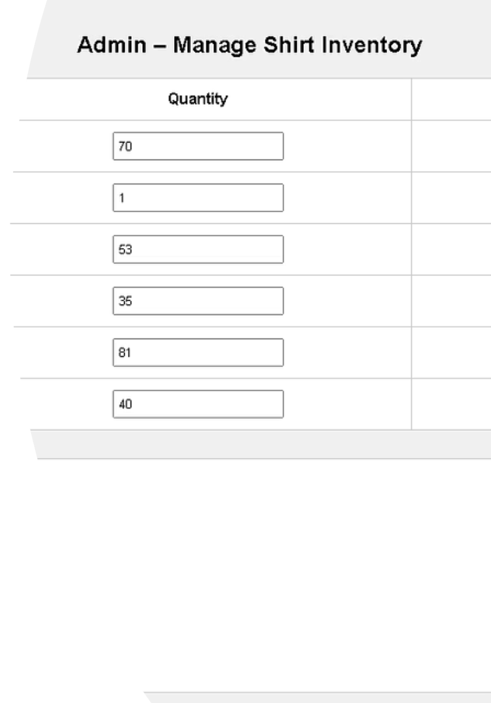
Website overview
The management section
This section is where the admin(s) in charge will be able change the quantity of the shirts or Add new shirts to the list
Notes:
9

Slide 11
Frontend to backend connection
To do this i did extensive research on how to use the following:
PHP forms for admin actions (login, update, add).
JSON API (backend.php) for dynamic stock checks.
Sessions (login.php) to maintain admin state.
Notes:
11

Slide 12
Highlights
This website was created to make the students shirt purchasing life easier but the highlight of this website was what the admins are capable of doing on the website behind the scenes .
Notes:
12

Slide 13
Uniqueness
This website is unique in the way that if it were to be taken up by the school that it would be the first of it kind,considering there is no online system in place at the moment.
Notes:
13

Slide 14
Security
For the students aspect there is no need for security because it serves as just a search feature from the database
For the admins there is reasonable amount of security ,as we mentioned above there is a page where the admins need to login using a username and password
Notes:
14

Slide 15
Limitations
I had several limitations but these were the main issues that i had:
The admin's panel showed the amount of shirts in stock but it does not show if a specific size quantity is low.
creating the data base and allowing the website to pull information from the data created.
I started the assignment on my personal desktop computer therefore it was a bit difficult sending the functioning files over to a laptop for presentation.
I also did not fully understand the purpose of using GitHub.
Notes:
15

Slide 16
Future Upgrades
In the future i would upgrade:
The User interface, i can admit it was a little bland and picture less i could take pointers from the employee version of the H&M website where the workers could check availability from other store departments but i wanted to keep it strictly professional.
The database, as identified above the database does not print each sizes quantity on whether a specific size is low on quantity.
The website entirely it could turn from a real-time stock checker into a fully functional buying website like amazon but just for school shirts.
Notes:
16

Slide 17
Lessons I Learned
Prior to picking this topic for my technical project i had little to no experience in building website not to mention from the ground up. The closest encounter i had was building a website on the platform Wix for Csec Information Technology.Doing this project Compared to that assignments is like child's play.
i am thankful for the opportunity of being able to do this i would most definitely further my skill due to what i have learned.
Notes:
17

Slide 18
Live Demonstration
here is the link to the website
http://localhost/salcc-shirt-admin/index.html
Notes:
18

